Slide 1
BCOG 100
Lecture 0.3: How to Do Well in This Class

Slide 2
How to Do Well in this Class (and College)
Attend class and discussion section
Do the assignments
Ask questions & come to office hours
Take notes and study using a proven method, like Cornell Notes & SQ3R

Slide 3
SQ3R
Survey
Question
Read
Recite (i.e. take notes here)
Review

Slide 4
Cornell Notes

Slide 5
How to Do Well in this Class (and College)
Attend class and discussion section
Do the assignments
Ask questions & come to office hours
Take notes and study using a proven method, like Cornell Notes & SQ3R
Use AI Appropriately (if at all)

Slide 6
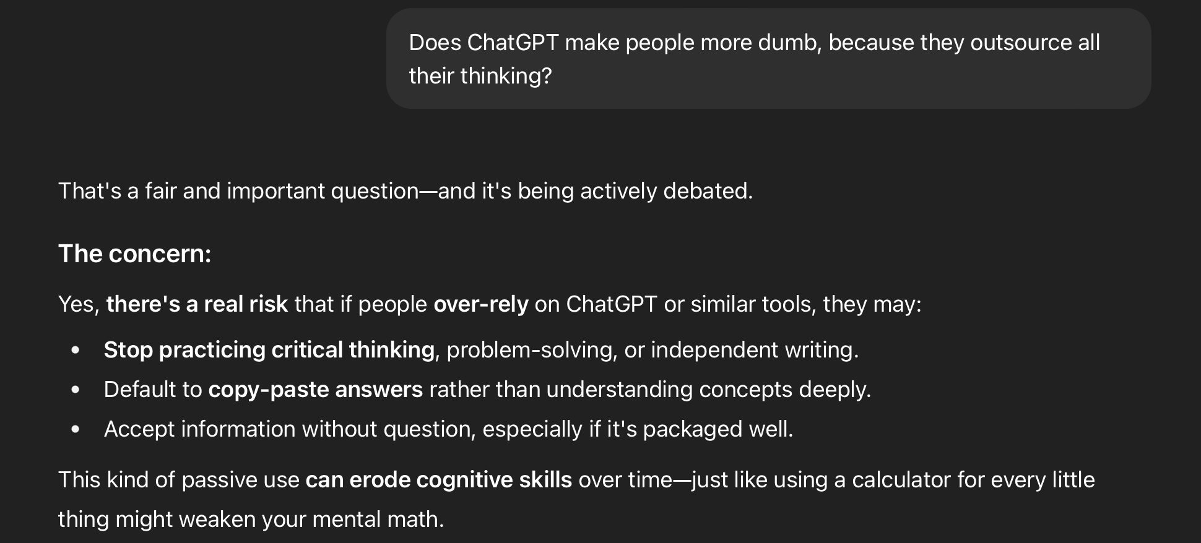
AI and Large Language Models

Slide 7
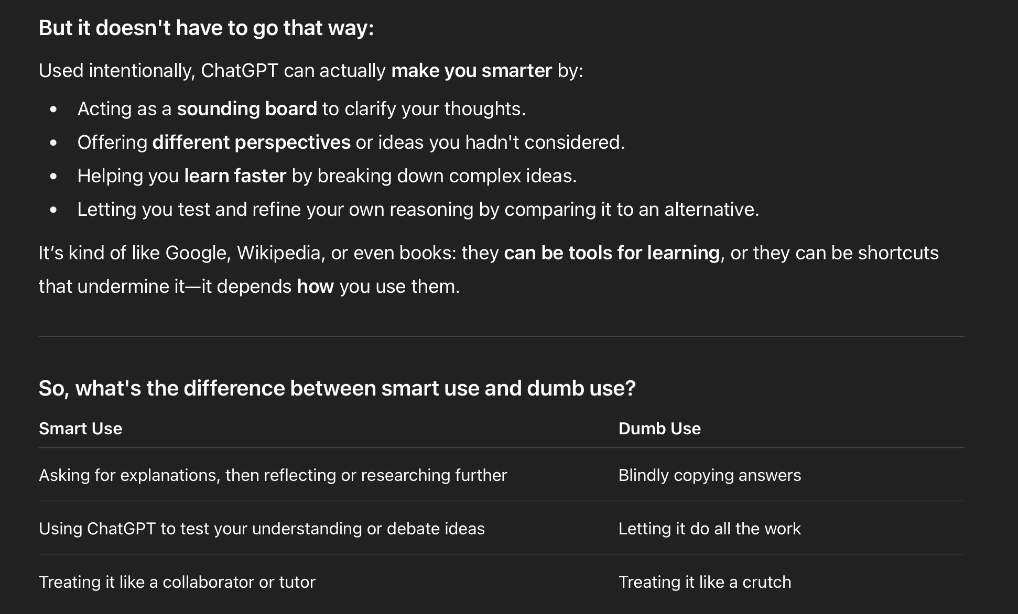
AI and Large Language Models

Slide 8
Take Care of Yourself
Make yourself a schedule and stick to it
Take care of your mind and body
Sleep,
Diet
Exercise
Life balance

